Slide 1


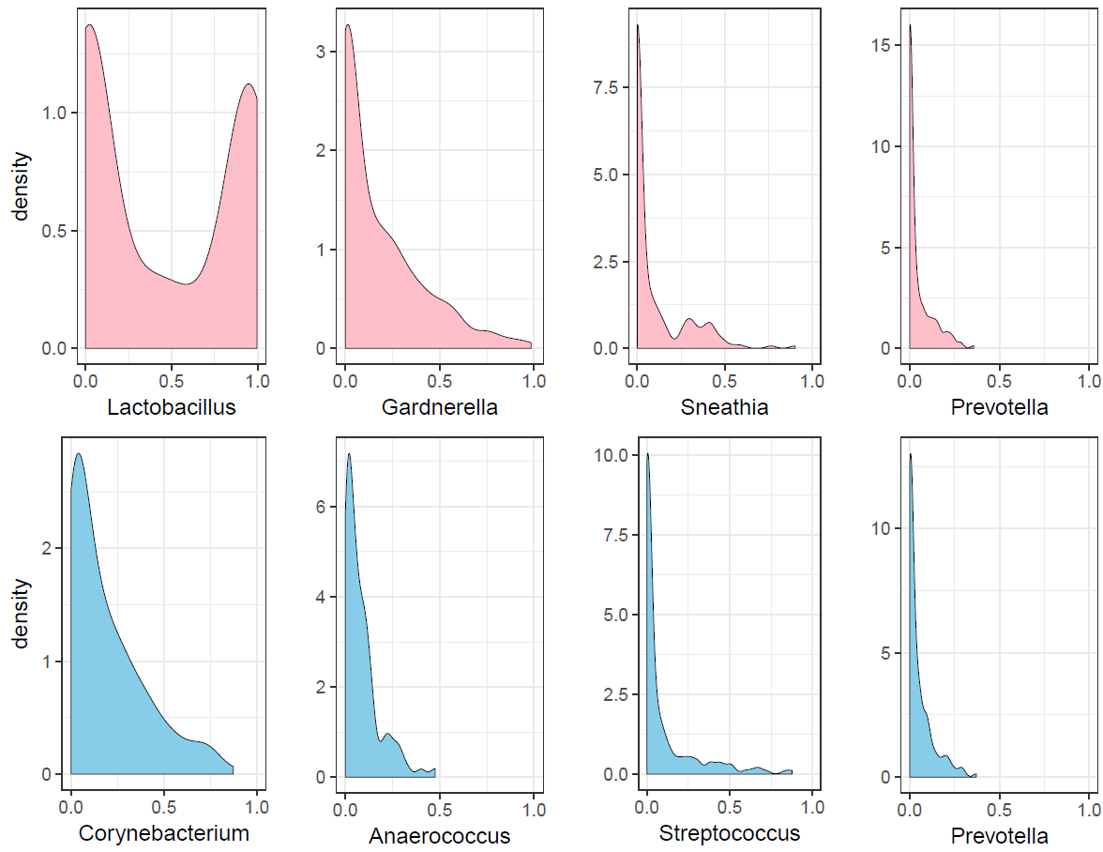
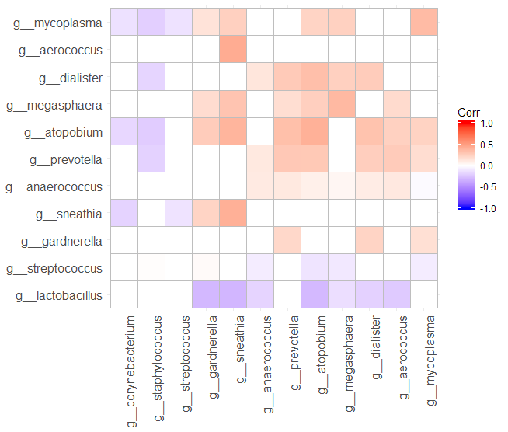
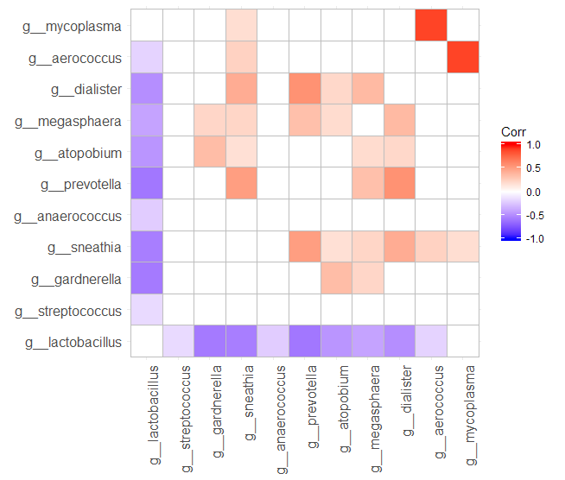
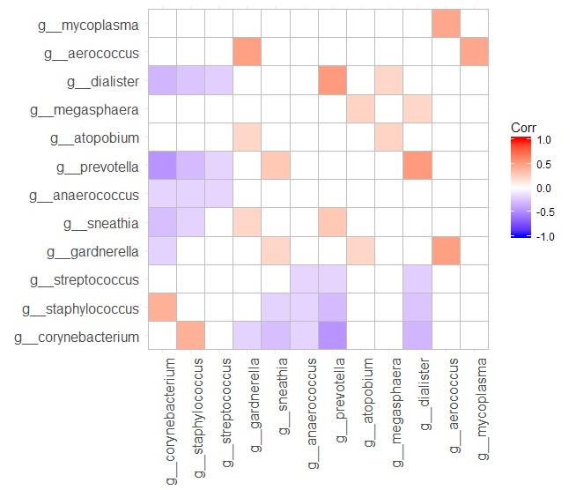
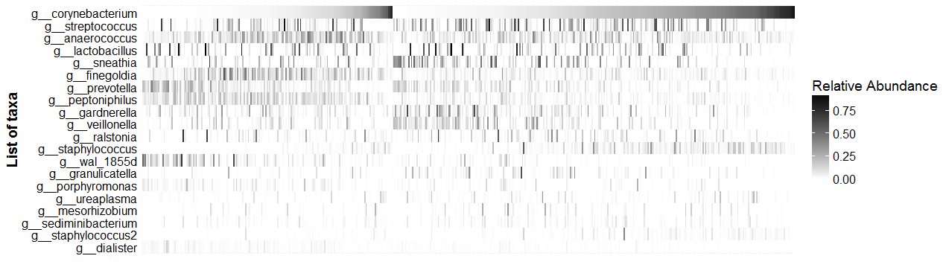
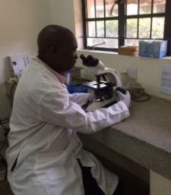
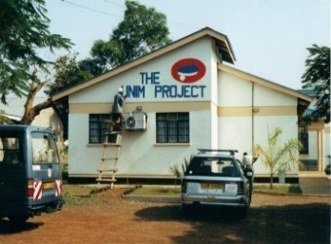
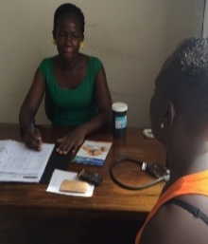
A 3-pronged methodological approach to longitudinal microbiome data analysis:
Addressing correlation, zero inflation, and interdependence
Rachel K. Nordgren¹, Stefan Green², Fredrick Otieno³, Walter Agingu³, Robert C. Bailey¹, Supriya D. Mehta¹
¹ Division of Epidemiology & Biostatistics, University of Illinois at Chicago School of Public Health, Chicago, IL, USA
² Department of DNA Services, University of Illinois at Chicago, Chicago, IL, USA • ³ Nyanza Reproductive Health Society, Kisumu, Kenya
Background
Baseline Characteristics of Males
Selected Taxa Densities at Baseline
Preliminary Results
Bacterial vaginosis (BV) has been linked to sex partner penile microbiome
We sought to define factors causing variation in the penile microbiome over time. This understanding may inform interventions aimed at promoting vaginal microbiome health
Median Age | 27 (IQR 24-30)
Circumcised | 56%
HSV-2 positive | 47%
Sex in past 2 days | 40%
Safe bath water | 69%
≥2 sex partners | 23%
HIV positive | 12%
BV in partner | 22%
Females
Males
Modeling circumcision status, HSV2 status, sex within last 2 days, safe bathing water, >2 sex partners in last 6 months with each of 5 bacterial taxa. Odds ratios (OR) for P<0.05 associations are in Table and below:
Mean amount of Corynebacterium is increased for circumcised men (OR=2.14) and safe water (OR=1.26), and decreased with HSV-2 seropositivity (OR=0.80)
Mean amount of Anaerococcus is reduced for circumcised men (OR=0.57), and HSV-2 seropositivity (OR=0.84), and increased with recent sex (OR=1.38).
Mean amount of Sneathia is increased with recent sex (OR=1.40) and multiple sex partners (OR=1.37)
Mean amount of Prevotella is reduced with circumcision (OR=0.58), and safe water (OR=0.79), and increased with multiple sex partners (OR=1.37)
Megasphaera presence is increased with recent sex (OR=1.62), multiple sex partners (OR=1.95); mean amount is reduced with circumcision (OR=0.51)
Dataset
Samples were collected from 252 male and female sex partners residing in Kisumu, Kenya, at baseline, 1 month, 6 months, and 12 months.
Covariates were collected for both partners: socio-demographics, sexual practices, Bacterial vaginosis, HIV, HSV-2
Bacterial Abundance Correlations across Selected Taxa at Baseline
(a) Female vs. Male
(b) Female only
(c) Male only
Brighter red (positive) and blue (negative) colors depict strength of correlation. (a) Female Lactobacillus abundance is inversely correlated with BV-associated bacterial abundances among male partners (e.g., blue Gardnerella, Sneathia, Atopobium, Dialister); BV-associated bacteria show positive correlation between partners. (b) Among females, Lactobacillus is inversely correlated with BV-associated bacteria (blue Gardnerella, Sneathia, etc.); Mycoplasma and Aerococcus abundances are strongly positively correlated. (c) Among males, Corynebacterium and Staphylococcus abundances are positively correlated, while Corynebacterium is negatively correlated with BV-associated bacteria.
Problems
Longitudinal microbiome analysis presents three challenges:
Taxa Interdependence: Different samples have different numbers of sequence reads. Relative abundance (RA) corrects for this, but adds interdependence since the sum for each sample is 1.
Observation Dependence: Samples from the same subject are related
Zero Inflation: Excess zeros and mixed distributions (0/1 mixed with counts)
Heatmap of Relative Abundance of Top 20 Taxa
Discussion
Zero Inflated Beta Regression allowed simultaneous modelling of presence and relative abundance of bacteria.
This approach maximizes efficient use of data, and management of correlated observations within subject over time, and taxa interdependence
Associations between bacteria and circumcision status are in keeping with the literature, and new bacterial associations were uncovered for HSV-2, sexual practices, and water source for bathing
Next steps will include modeling bacterial clusters and the interaction with vaginal microbiome
Heat map of Relative Abundance of each bacteria for each observation (N=488), sorted on male circumcision status (circumcised right, uncircumcised left) and amount of Corynebacterium
Methods
Results of Multivariable Beta Regression for five penile bacteria, each modelled separately.
Normalize samples by dividing by total number of reads (RA)
Examine clusters of taxa created by biome interactions and normalization
Model RA using beta regression in R
Use zero-inflation to handle 0s
Include a random subject intercept to correct for correlation between repeated measurements
 | Circ’ed | HSV-2 | Recent sex | Safe bath water | ≥2 sex partners
Anaerococcus | ↓ 0.57 | ↓ 0.84 | ↑ 1.38
Corynebacterium | ↑ 2.14 | ↓ 0.80 |  | ↑ 1.26
Sneathia |  |  | ↑ 1.40 |  | ↑ 1.37
Prevotella | ↓ 0.58 |  |  | ↓ 0.79 | ↑ 1.37
Megasphaera | ↓ 0.51 |  | ⇡ 1.62 |  | ⇡ 1.95
↑ = amount increased ⇡ = presence increased
Acknowledgements
NIH, NIAID, DMID R01 AI110369 (PI: Mehta)
Staff and participants in Kisumu

